Slide 1
Storage Management Module 5.1

Slide 2
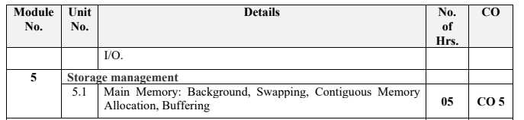

Slide 3
How do you differentiate?
Memory
Main memory
Physical Memory
RAM
Primary memory

Slide 4
Basics
Memory is central to operation of computing systems
Memory = a large array of words/bytes
Each byte or word has own address
Memory contains the program to be executed and data, both
Program is executed line by line with Instruction Fetch, Instruction Decode, Operand Fetch, Execute cycles
Program counter contains address of memory location to be executed next

Slide 5
Background
Memory consists of a large array of words or bytes, each with its own address.
The CPU fetches instructions from memory according to the value of the program counter. These instructions may cause additional loading from and storing to specific memory addresses.

Slide 6
Background
A typical instruction-execution cycle, for example,
first fetches an instruction from memory.
The instruction is then decoded and may cause operands to be fetched from memory.
After the instruction has been executed on the operands, results may be stored back in memory.
Memory unit only sees a stream of addresses + read requests, or address + data and write requests

Slide 7
Memory : hardware
CPU can directly access only main memory and processor registers
The instructions take main memory addresses as program arguments and not disk addresses
Hence- Data and instructions executing them, have to be in MM
Issues and concerns?
Speed of access : solution 🡺 cache memory
Protect program data : solution 🡺 base and limit registers
Size of memory : solution 🡺 swapping, virtual memory
Many more ones….

Slide 8
Basic Hardware
Register access in one CPU clock (or less)
Main memory access can take many cycles, causing a stall
Cache sits between main memory and CPU registers
Protection of memory required to ensure correct operation

Slide 9
Basic Hardware
Register access in one CPU clock (or less)
Main memory access can take many cycles, causing a stall
Cache sits between main memory and CPU registers
Protection of memory required to ensure correct operation
Registers that are built into the CPU are generally accessible within one cycle of the CPU clock.

Slide 10
Basic Hardware
Register access in one CPU clock (or less)
Main memory access can take many cycles, causing a stall
Cache sits between main memory and CPU registers
Protection of memory required to ensure correct operation
Main memory is accessed via a transaction on the memory bus.
Completing a memory access may take many cycles of the CPU clock.
In such cases, the processor normally needs to stall, since it does not have the data required to complete the instruction that it is executing

Slide 11
Speed of access
One of the Speed judgement parameters: number of CPU clock cycles needed to perform memory operation
CPU is a faster than memory
CPU registers are accessible in one CPU clock cycle
But MM is accessed via a transaction on memory bus
This access takes many CPU clocks to complete
Result? : CPU has program but not the data to complete instruction execution i.e. CPU stalling

Slide 12
Basic Hardware
Register access in one CPU clock (or less)
Main memory access can take many cycles, causing a stall
Cache sits between main memory and CPU registers
Protection of memory required to ensure correct operation
The remedy is to add fast memory between the CPU and main memory called cache.

Slide 13
Speed of access
As the data are needed always for instruction execution, frequent memory stalls are bottleneck
Solution : add a faster memory between CPU and main memory i.e. cache memory
Cache memory: a buffer to accommodate the speed difference

Slide 14
Basic Hardware
Register access in one CPU clock (or less)
Main memory access can take many cycles, causing a stall
Cache sits between main memory and CPU registers
Protection of memory required to ensure correct operation
Apart from relative speed of accessing physical memory, we also must ensure correct operation.
To protect the operating system from access by user processes
To protect user processes from one another. This protection must be provided by the hardware.

Slide 15
Access Protect
OS must be protected from unauthorized access by user process
User processes must be protected from each other
Each process has range of legal addresses to access
Base register and limit register ensure process can access only addresses within the legal range
Image courtesy: Galvin

Slide 16
Basic Hardware
We first need to make sure that each process has a separate memory space.
Determine the range of legal addresses that the process may access
To ensure that the process can access only these legal addresses.
We can provide this protection by using two registers, usually a base and a limit.

Slide 17
Base and Limit Registers
Base Register-Holds the smallest legal physical memory address
Limit Register- specifies the size of the range.

Slide 18
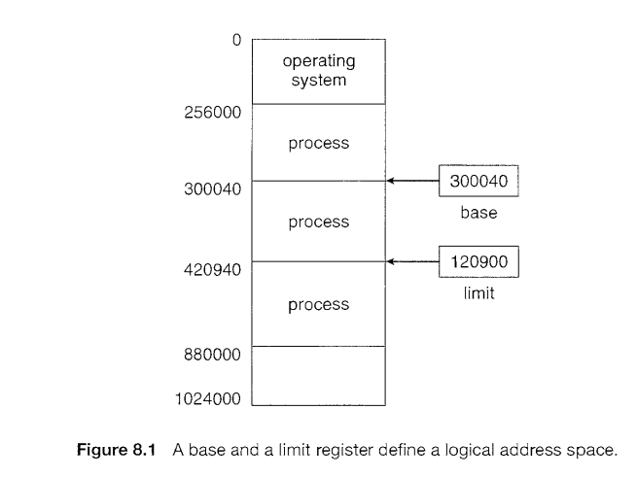
Base and Limit Registers
For example,
if the base register holds 300040
and the limit register is 120900,
then the program can legally access all addresses from 30 0040 through 420939 (inclusive).

Slide 19
Base and Limit Registers
Protection of memory space is accomplished by having the CPU hardware compare every address generated in user mode with the registers.
Any attempt by a program executing in user mode to access operating-system memory or other users' memory
Results in a trap to the operating system, which treats the attempt as a fatal error
This scheme prevents a user program from (accidentally or deliberately) modifying the code or data structures of either the operating system or other users.

Slide 20
Base and Limit Registers
CPU must check every memory access generated in user mode to be sure it is between base and limit for that user

Slide 21
Hardware Address Protection
The base and limit registers can be loaded only by the operating system, which uses a special privileged instruction.
Since privileged instructions can be executed only in kernel mode,
since only the operating system executes in kernel mode,
only the operating system can load the base and limit registers.
This scheme allows the operating system to change the value of the registers but prevents user programs from changing the registers' contents.

Slide 22
Hardware Address Protection
The operating system, executing in kernel mode, is given unrestricted access to both operating system memory and users' memory.
This provision allows the operating system
to load users' programs into users' memory,
to dump out those programs in case of errors

Slide 23
Address Binding
Usually, a program resides on a disk as a binary executable file.
To be executed, the program must be brought into memory and placed within a process.
Programs on disk, ready to be brought into memory to execute form an input queue
The normal procedure is to select one of the processes in the input queue and to load that process into memory.
As the process is executed, it accesses instructions and data from memory.
Eventually, the process terminates, and its memory space is declared available.

Slide 24
Address binding
User processes reside in any part of main memory
Computer address space starts at 00000
But user process need not be loaded at 00000
The program is processed by various system softwares before being executed such as macro processor, compiler, linker, loader etc..
User program addresses may be represented in various ways during these executions

Slide 25
Address binding.. contd
Addresses in source program are symbolic
Compiler binds symbolic addresses to relocatable addresses
E,g. 14 bytes from beginning of this module
The linker or loaders turn relocatable addresses to absolute addresses
Each such binding is mapping from one address space to another

Slide 26
Address Binding
Further, addresses represented in different ways at different stages of a program’s life
Source code addresses are usually symbolic (Eg-count)
A compiler will typically bind these symbolic addresses to relocatable addresses
i.e. “14 bytes from beginning of this module”
Linker or loader will bind relocatable addresses to absolute addresses
i.e. 74014
Each binding maps from one address space to another

Slide 27
Binding of Instructions and Data to Memory
The binding of instructions and data to memory addresses i.e.
Address binding of instructions and data to memory addresses can happen at three different stages
Compile time
Load time
Execution time

Slide 28
Binding instructions & data to memory
Can be done at any step during execution based on available info
If known at Compile time:
generates absolute code that resides at given memory.
Re-compile if the starting location changes
If known at Load time but not at compile time:
Generates relocatable code
Final binding is delayed until load time
If starting address changes, only reload the user code to incorporate the changed value
If known at Execution time
If process can be moved from one memory segment to another during execution
Binding is delayed until run time
Needs special hardware

Slide 29
Binding of Instructions and Data to Memory
Compile time:
If you know at compile time where the process will reside in memory, then absolute code can be generated.
If memory location known a priori,
For example, if you know that a user process will reside starting at location R, then the generated compiler code will start at that location and extend up from there.
Must recompile code if starting location changes-
If, at some later time, the starting location changes, then it will be necessary to recompile this code.

Slide 30
Binding of Instructions and Data to Memory
Load time:
Must generate relocatable code if memory location is not known at compile time
If it is not known at compile time where the process will reside in memory, then the compiler must generate relocatable code
In this case, final binding is delayed until load time.
If the starting address changes, we need only reload the user code to incorporate this changed value.

Slide 31
Binding of Instructions and Data to Memory
Execution time:
If the process can be moved during its execution from one memory segment to another, then binding must be delayed until run time.
Need hardware support for address maps (e.g., base and limit registers)

Slide 32

Multistep Processing of a User Program

Slide 33
Logical Vs physical address space
Logical address: An address generated by CPU
Physical address : an address loaded into memory address register of memory
The compile time and load time address-binding methods generate identical logical and physical address
But, execution time binding results in different logical and physical address space
Logical address space: set of all addresses generated by a program
Physical address space: set of all physical addresses corresponding to all logical addresses

Slide 34
Logical vs. Physical Address Space
Logical address –
An address generated by the CPU
also referred to as virtual address
Physical address –
Address seen by the memory unit
that is, the one loaded into memory address register of the memory
Logical address space- the set of all logical addresses generated by a program
Physical address space- the set of all physical addresses corresponding to these logical addresses

Slide 35
Logical vs. Physical Address Space
Logical and physical addresses are the same in compile-time and load-time address-binding schemes;
Logical (virtual) and physical addresses differ in execution-time address-binding scheme

Slide 36
Memory-Management Unit (MMU)
The run-time mapping from virtual to physical addresses is done by a hardware device called the MMU
Many methods possible for this mapping

Slide 37
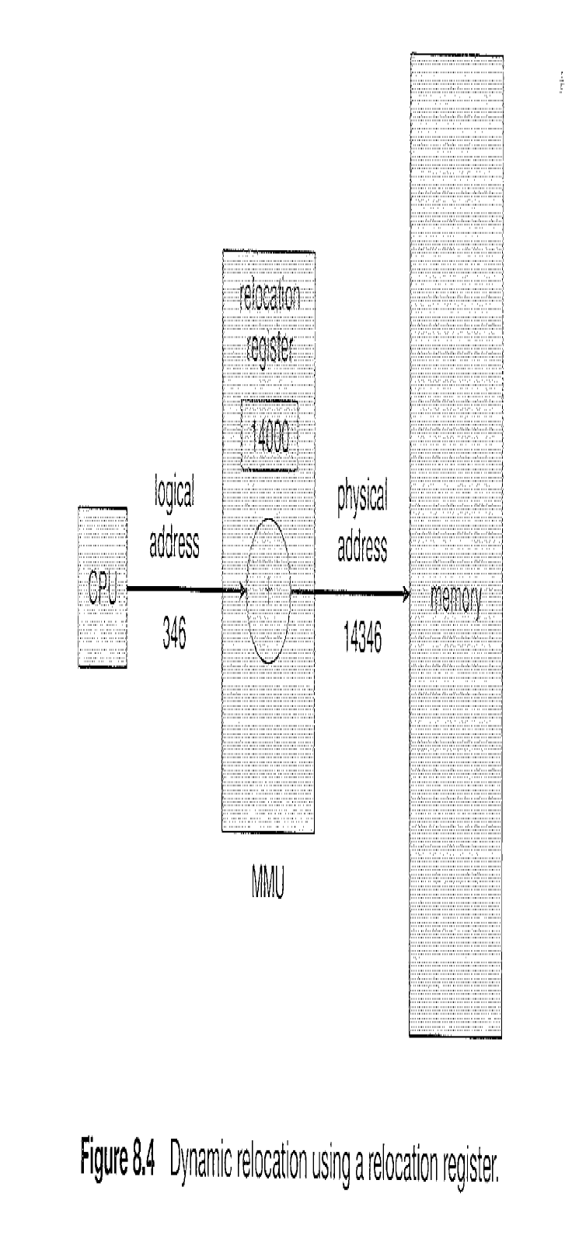
MMU
MMU (memory management unit) maps virtual addresses to physical addresses
Simple MMU scheme: generalization of base-register scheme
Base register is called relocation register
While sending to memory, relocation register value is added to every address generated by user process

Slide 38
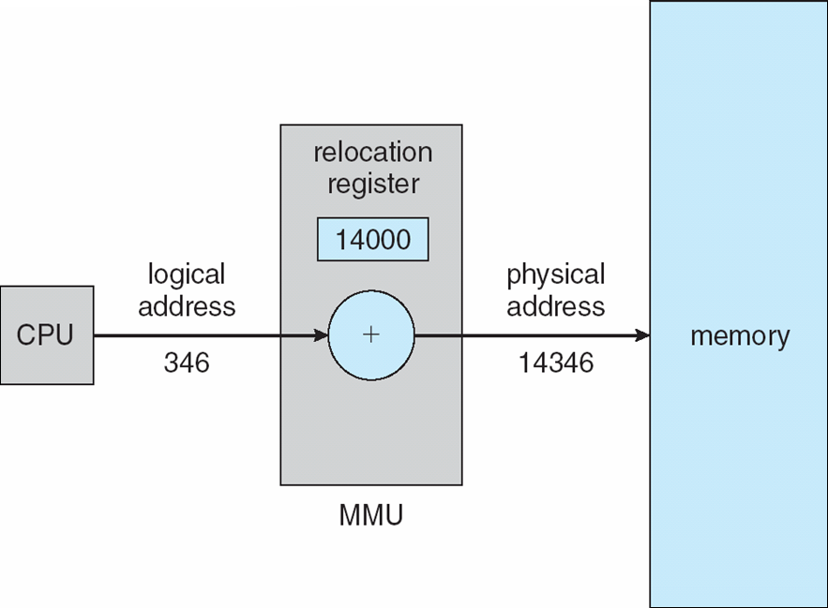
Memory-Management Unit (MMU)
To start, consider simple scheme –
Base register now called relocation register
The value in the relocation register is added to every address generated by a user process at the time it is sent to memory

Slide 39
Memory-Management Unit (MMU)
For example,
if the reloacation is at 14000,
then an attempt by the user to address location 0 is dynamically relocated to location 14000;
an access to location 346 is mapped to location 14346.

Slide 40
The user program never sees the ‘real’ physical address.
User program deals with logical addresses
The memory mapping hardware converts logical addresses to physical addresses
Logical addresses: Range is 0 to max
Physical addresses: R+0 to R+max where R is base value

Slide 41
Dynamic Loading
So far:-
The entire program and all data of a process to be in physical memory for the process to execute.
The size of a process has thus been limited to the size of physical memory.

Slide 42
Dynamic Loading
To obtain better memory-space utilization,
we can use Dynamic Loading

Slide 43
Multistep Processing of a User Program

Slide 44
Dynamic Loading
Routine is not loaded until it is called
All routines kept on disk in relocatable load format
The main program is loaded into memory and is executed.
When a routine needs to call another routine, the calling routine first checks to see whether the other routine has been loaded.
If it has not, the relocatable linking loader is called to load the desired routine into memory and to update the program's address tables to reflect this change.
Then control is passed to the newly loaded routine.

Slide 45
Dynamic Loading
Advantage –
Unused routine is never loaded.
Useful when large amounts of code are needed to handle infrequently occurring cases. Eg- Error Routines
No special support from the operating system is required
Implemented through program design-
It is the responsibility of the users to design their programs to take advantage of such a method.
Operating systems may help the programmer,
by providing library routines to implement dynamic loading.

Slide 46
Dynamic Linking
Static linking –
System libraries and program code combined by the linker/loader into the binary program image
Dynamic linking –linking postponed until execution time

Slide 47
Dynamic Linking
Dynamic linking –
This feature is usually used with system libraries, such as language subroutine libraries.
Without this facility, each program on a system must include a copy of its language library (or at least the routines referenced by the program) in the executable image.
This requirement wastes both disk space and main memory.

Slide 48
Dynamic Linking
A stub is included in the image for each library routine reference.
The stub is a small piece of code that indicates how to locate the appropriate memory-resident library routine or how to load the library if the routine is not already present.

Slide 49
Dynamic Linking
When the stub is executed,
It checks to see whether the needed routine is already in memory.
If it is not, the program loads the routine into memory.
Either way, the stub replaces itself with the address of the routine and executes the routine.
Thus, the next time that particular code segment is reached, the library routine is executed directly, incurring no cost for dynamic linking.

Slide 50
Dynamic Linking
This feature can be extended to library updates (such as bug fixes).
A library may be replaced by a new version,
All programs that reference the library will automatically use the new version. Without dynamic linking, all such programs would need to be relinked to gain access to the new library.

Slide 51
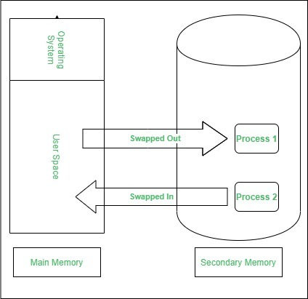
Swapping
Swapping is a process of swapping a process temporarily to a secondary memory from the main memory

Slide 52

Swapping
A process can be swapped temporarily out of memory to a backing store, and then brought back into memory for continued execution

Slide 53
Swapping
Backing store –
fast disk large enough to accommodate copies of all memory images for all users;
must provide direct access to these memory images

Slide 54
Swapping
Q
MMU /Dispatcher
For example,
Assume a multiprogramming environment with a round-robin CPU-scheduling algorithm.
When a quantum expires, the memory manager will start to swap out the process that just finished and to swap another process into the memory space that has been freed
In the meantime, the CPU scheduler will allocate a time slice to some other process in memory.
When each process finishes its quantum, it will be swapped with another process.
Ideally, the memory manager can swap processes fast enough that some processes will be in memory, ready to execute, when the CPU scheduler wants to reschedule the CPU.

Slide 55
Swapping
Roll out, roll in –
A variant of this swapping policy is used for priority-based scheduling algorithms.
If a higher-priority process arrives and wants service,
The memory manager can swap out the lower-priority process and then load and execute the higher-priority process.
When the higher-priority process finishes, the lower-priority process can be swapped back in and continued.
This variant of swapping is sometimes called roll out, roll in.

Slide 56
Swapping
Major part of swap time is transfer time;
total transfer time is directly proportional to the amount of memory swapped
System maintains a ready queue of ready-to-run processes which have memory images on disk

Slide 57
Swapping (Cont.)
Does the swapped out process need to swap back in to same physical addresses?

Slide 58
Swapping
Normally, a process that is swapped out will be swapped back into the same memory space it occupied previously.
The restriction is dictated by the method of address binding.
If binding is done at assembly/Compile or load time, then the process cannot be easily moved to a different location.
if execution time binding is being used, then a process can be swapped into a different memory space as the physical addresses are computed at execution time

Slide 59
Dispatcher and swapper
Swapping requires a backing store.
The backing store is commonly a fast disk, large enough to accommodate copies of all memory images for all users
Provides direct access to these memory images.
The system maintains a ready queue of all processes whose memory images are in memory and are ready to run.
Whenever the CPU scheduler decides to execute a process, it calls the dispatcher.
The dispatcher checks to see whether the next process in the queue is in memory.
If it is not, and if there is no free memory region, the swapper swaps out a process currently in memory and swaps in the desired process.
It then reloads registers and transfers control to the selected process.

Slide 60
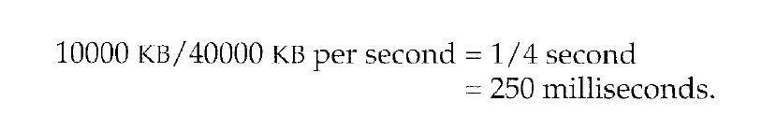
The context-switch time in such a swapping system is fairly high.
Assume a user process of 10 MB size and the backing store is a standard hard disk with a transfer rate of 40 MB per second. The actual transfer of the 10-MB process to or from main memory takes:
Assuming that no head seeks are necessary, and assuming an average latency of 8 milliseconds, the swap time is 258 milliseconds.
Considering both swap out and swap in, the total swap time = 516 milliseconds.
For efficient CPU utilization, the execution time for each process should be long relative to the swap time.
Thus, in a round-robin CPU-scheduling algorithm, for example, the time quantum should be substantially larger than 0.516 seconds.

Slide 61
Swapping (Cont.)
Modified versions of swapping are found on many systems (i.e., UNIX, Linux, and Windows)
Swapping normally disabled
Started if more than threshold amount of memory allocated
Disabled again once memory demand reduced below threshold

Slide 62
Schematic View of Swapping

Slide 63
Contiguous Allocation
Main memory must support both OS and user processes
Limited resource, must allocate efficiently
Contiguous allocation per process is one early method

Slide 64
Memory allocation to OS and User programs
The main memory must accommodate both the operating system and the various user processes.
Hence, OS needs to allocate the parts of the main memory in the most efficient way possible.
The memory is divided into two partitions:
For the resident operating system and
For the user processes.
So the operating system in either low memory or high memory.
The major factor affecting this decision is the location of the interrupt vector.
Since the interrupt vector is often in low memory, programmers usually place the operating system in low memory as well.
User processes then held in high memory

Slide 65
Contiguous Allocation
In contiguous memory allocation, each process is contained in a single contiguous section of memory.

Slide 66
Memory Mapping and Protection
To protect user processes from each other, and from changing operating-system code and data by using a relocation register together with a limit register.
The relocation register contains the value of the smallest physical address
The limit register contains the range of logical addresses – each logical address must be less than the limit register

Slide 67

Memory Mapping and Protection
Each logical address must be less than the limit register;
The MMU maps the logical address dynamically by adding the value in the relocation register.
This mapped address is sent to memory
(for example, relocation= 100040 and limit= 74600).

Slide 68
Hardware Support for Relocation and Limit Registers

Slide 69
Types of Memory Management Techniques
Contiguous
Non-Contiguous

Slide 70
In Contiguous Technique, executing process must be loaded entirely in the main memory.
The contiguous Technique can be divided into:
Fixed (or static) partitioning
Variable (or dynamic) partitioning

Slide 71
Fixed partitioning
Also known as static partitioning,
No of Partitions are fixed
In this partitioning, the number of partitions (non-overlapping) in RAM is fixed but the size of each partition may or may not be the same.

Slide 72
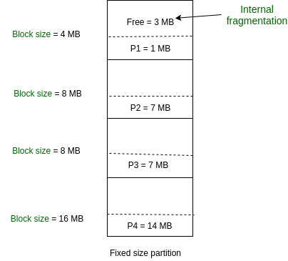
Fixed partitioning
Is a memory allocation technique used in operating systems to divide the physical memory into fixed-size partitions or regions, each assigned to a specific process or user.
Partitions are made before execution or during system configure.
Each partition remains dedicated to a specific process until it terminates or releases the partition.

Slide 73
Fixed partitioning
Disadvantages:
It can lead to internal fragmentation, where memory in a partition remains unused. This can happen when the process’s memory requirements are smaller than the partition size, leaving some memory unused

Slide 74
Memory Allocation-Fixed Size Partitions
One of the simplest methods for allocating memory is –
To divide memory into several fixed-sized partitions.
Each partition may contain exactly one process.
Thus, the degree of multiprogramming is bound by the number of partitions.
In this Multiple partition method, when a partition is free, a process is selected from the input queue and is loaded into the free partition.
When the process terminates, the partition becomes available for another process.
This method was originally used by the IBM OS/360 operating system (called MFT); it is no longer in use.

Slide 75
Memory Allocation-Fixed Size Partitions
As processes enter the system, they are put into an input queue.
At any given time, then, we have a list of available block sizes and an input queue.
The operating system can order the input queue according to a scheduling algorithm.
Process selected from input queue is allocated memory from a hole large enough to accommodate it
The operating system can wait until a large enough block is available,
or it can skip down the input queue to see whether the smaller memory requirements of some other process can be met.

Slide 76
Memory Allocation-Fixed Size Partitions
The memory blocks available comprise a set of holes of various sizes scattered throughout memory.
When a process arrives and needs memory, the system searches the set for a hole that is large enough for this process.
If the hole is too large, it is split into two parts.
One part is allocated to the arriving process;
the other is returned to the set of holes.

Slide 77
Memory Allocation-Fixed Size Partitions
When a process terminates, it releases its block of memory, which is then placed back in the set of holes.
If the new hole is adjacent to other holes, these adjacent holes are merged to form one larger hole.
At this point, the system may need to check whether there are processes waiting for memory and whether this newly freed and recombined memory could satisfy the demands of any of these waiting processes.

Slide 78
Variable (or Dynamic) Partitioning
In contrast with fixed partitioning, partitions are not made before the execution or during system configuration.
No of partitions are not fixed

Slide 79
Variable (or Dynamic) Partitioning
Features:
Initially, RAM is empty and partitions are made during the run-time according to the process’s need instead of partitioning during system configuration.
The size of the partition will be equal to the incoming process.
The partition size varies according to the need of the process so that internal fragmentation can be avoided to ensure efficient utilization of RAM.
The number of partitions in RAM is not fixed and depends on the number of incoming processes and the Main Memory’s size.

Slide 80
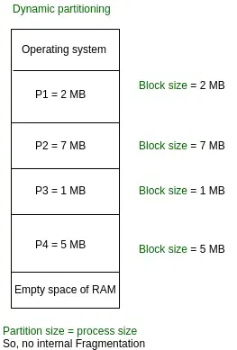
Variable (or Dynamic) Partitioning

Slide 81
Memory Allocation
In the Variable Partition scheme,
The operating system keeps a table indicating which parts of memory are available and which are occupied.
Initially, all memory is available for user processes and is considered one large block of available memory-a Hole.
Eventually as you will see, memory contains a set of holes of various sizes.
“Hole – block of available memory; holes of various size are scattered throughout memory”

Slide 82
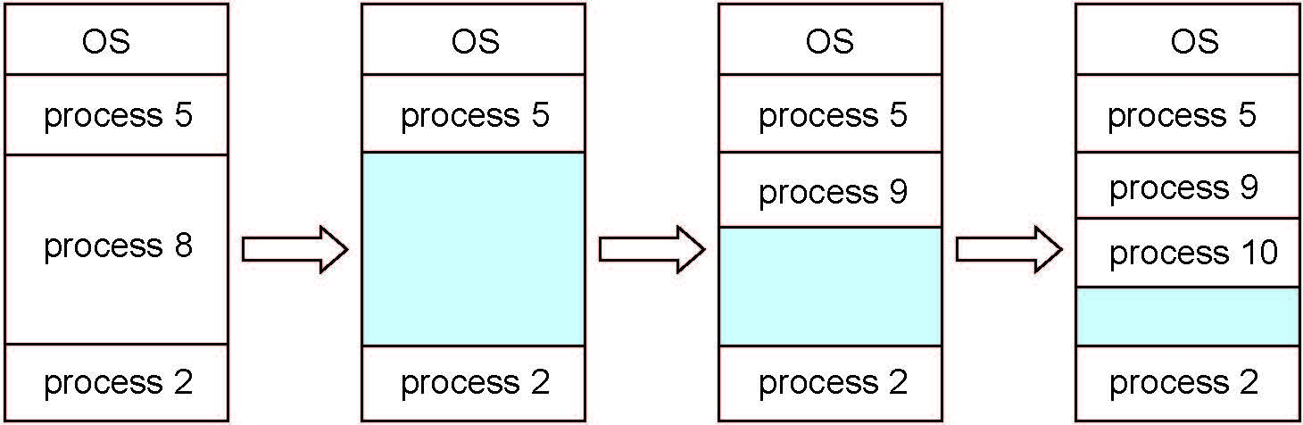
Multiple-partition allocation
Variable-partition sizes for efficiency (sized to a given process’ needs)
Hole – block of available memory; holes of various size are scattered throughout memory
When a process arrives, it is allocated memory from a hole large enough to accommodate it
Process exiting frees its partition, adjacent free partitions combined
Operating system maintains information about: a) allocated partitions b) free partitions (hole)

Slide 83
Dynamic Storage-Allocation Problem
How to satisfy a request of size n from a list of free holes?
First-fit
Best-fit
Worst-fit

Slide 84
Dynamic Storage-Allocation Problem
How to satisfy a request of size n from a list of free holes?
First-fit:
Allocate the first hole that is big enough
Searching can start either at the beginning of the set of holes or at the location where the previous first-fit search ended.
We can stop searching as soon as we find a free hole that is large enough.

Slide 85
Dynamic Storage-Allocation Problem
How to satisfy a request of size n from a list of free holes?
Best-fit:
Allocate the smallest hole that is big enough;
We must search entire list, unless ordered by size
This strategy produces the smallest leftover hole

Slide 86
Dynamic Storage-Allocation Problem
How to satisfy a request of size n from a list of free holes?
Worst-fit:
Allocate the largest hole;
We must also search entire list unless it is sorted by size.
This strategy produces the largest leftover hole which may be more useful than the smaller leftover hole from a best-fit approach.

Slide 87
Dynamic Storage-Allocation Problem
Simulations have shown that
Both first fit and best fit are better than worst fit in terms of decreasing time and storage utilization.
Neither first fit nor best fit is clearly better than the other in terms of storage utilization, but first fit is generally faster.

Slide 88
Dynamic Storage-Allocation Problem
How to satisfy a request of size n from a list of free holes?
First-fit: Allocate the first hole that is big enough
Best-fit: Allocate the smallest hole that is big enough; must search entire list, unless ordered by size
Produces the smallest leftover hole
Worst-fit: Allocate the largest hole; must also search entire list
Produces the largest leftover hole
First-fit and best-fit better than worst-fit in terms of speed and storage utilization

Slide 89
Fragmentation
As processes are loaded and removed from memory, the free memory space is broken into little pieces

Slide 90
Fragmentation
Memory fragmentation can be-
External Fragmentation
Internal Fragmentation

Slide 91
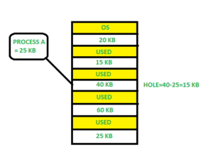
Fragmentation
External Fragmentation –
Total memory space exists to satisfy a request, but it is not contiguous
Storage is fragmented into a large number of small holes.
This fragmentation problem can be severe
In the worst case,
A block of free (or wasted) memory between every two processes.
If all these small pieces of memory were in one big free block instead, we might be able to run several more processes.

Slide 92
Fragmentation
Internal Fragmentation –
Allocated memory may be slightly larger than requested memory;
This size difference is memory internal to a partition, but not being used
Unused Memory Internal to a partition

Slide 93
Fragmentation
Internal Fragmentation –
Consider a multiple-partition allocation scheme with a hole of 18,464 bytes.
Suppose that the next process requests 18,462 bytes.
If we allocate exactly the requested block,
We are left with a hole of 2 bytes.

Slide 94
Fragmentation
First fit analysis reveals that given N blocks allocated, 0.5 N blocks lost to fragmentation
1/3 may be unusable -> 50-percent rule

Slide 95
Fragmentation (Cont.)
Reduce external fragmentation by compaction
Shuffle memory contents to place all free memory together in one large block
Compaction is possible only if relocation is dynamic, and is done at execution time
If addresses are relocated dynamically, relocation requires only moving the program and data and then changing the base register to reflect the new base address.

Slide 96
Fragmentation (Cont.)
The simplest compaction algorithm is
To move all processes toward one end of memory;
all holes move in the other direction,
producing one large hole of available memory.
This scheme can be expensive.

Slide 97
Fragmentation (Cont.)
Another possible solution-
To permit the logical address space of the processes to be non contiguous,
thus allowing a process to be allocated physical memory wherever such memory is available.

Slide 98
Non-Contiguous Memory Allocation
In this technique, each process is allocated a series of non-contiguous blocks of memory that can be located anywhere in the physical memory.
Paging and Segmentation are the two ways that allow a process’s physical address space to be non-contiguous. It has the advantage of reducing memory wastage but it increases the overheads due to address translation. It slows the execution of the memory because time is consumed in address translation.

